Slide 1


Slide 2
Error pages
Notes:
HELLO EVERBODY.
IN THIS COURSE, WE ARE GOING TO COVER THE FAMOUS SPRING BOOT WHITELABEL ERROR PAGE.
WE WILL BE COVERING HOW TO DISABLE THE DEFAULT ERROR PAGE AND HOW WE CAN CUSTOMIZE THE WHITELABEL ERROR PAGE IN YOUR SPRING BOOT APPLICATION.

Slide 3

Error page need
Notes:
A COMMON REQUIREMENT IN ANY WEB APPLICATION ARE CUSTOMIZED ERROR PAGES.
FOR INSTANCE, SUPPOSE YOU’RE RUNNING A SPRING MVC APP ON TOP OF TOMCAT.
A USER ENTERS AN INVALID URL IN HIS BROWSER AND IS SHOWN A NOT SO USER-FRIENDLY.

Slide 4
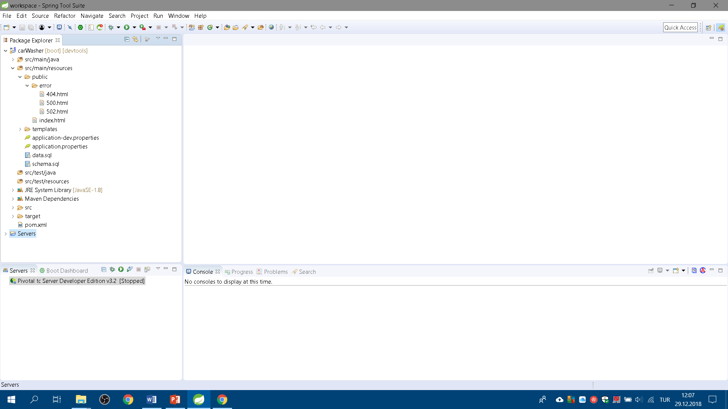
Spring Boot and error pages
Notes:
IF WE JUST WANT CREATE BASIC WEB ERROR PAGES ACCOORDING TO THE ERROR CODES, IT WILL BE ENOUGH TO CREATE AN HTML PAGE UNDER THE “ERROR” FOLDER IN THE STATIC RESURCES FOLDER.
FOR EXAMPLE IF WE WANT TO CUSTOMIZE THE ERROR PAGES FOR THE ERROR CODE “500” WE WILL CREATE “500.HTML” IN “/ERROR” FOLDER IN STATIC RESOURCES PATH. LIKE THIS WE CAN CREATE ERROR PAGES FOR THE ERROR CODES 400,401,500,502 ETC.
THERE ARE MULTIPLE OTHER WAYS TO DISABLE THIS BEHAVIOR IN YOUR SPRING BOOT APPLICATION.
LET’S COVER SOME OF THE COMMON OPTIONS TO DO THIS.

Slide 5
Spring Boot and error pages
«server.error.whitelabel.enabled» property
«spring.autoconfigure.exclude» property
«EnableAutoConfiguration» annotation params
Notes:
SPRING BOOT PROVIDES AN APPLICATION.PROPERTIES (OR YAML) FILE TO EASILY CONFIGURE/CHANGE YOUR APPLICATION.
{click} WE CAN USE THE SAME PROPERTY FILE TO DISABLE THIS ERROR PAGE GLOBALLY. SET SERVER.ERROR.WHITELABEL.ENABLED TO FALSE TO ACHIEVE THIS.PLEASE BE AWARE THAT USING THIS CONFIGURATION WILL RESTORE THE DEFAULT OF THE SERVLET CONTAINER THAT YOU ARE USING. THIS MEANS THAT IF YOU ARE NOT USING ANY CUSTOM ERROR PAGE, THE DEFAULT SERVLET CONTAINER ERROR PAGE SHOWN TO THE CUSTOMER (LIKE DEFAULT TOMCAT SERVER ERROR PAGE).
{click} ANOTHER OPTION IS TO EXCLUDE ERRORMVCAUTOCONFIGURATION FROM YOUR APPLICATION USING A PROPERTY AS “SPRING.AUTOCONFIGURE.EXCLUDE=ORG.SPRINGFRAMEWORK.BOOT.AUTOCONFIGURE.WEB.SERVLET.ERROR.ERRORMVCAUTOCONFIGURATION”.
{click} INCASE YOU LIKE TO EXCLUDE USING THE CODE, YOU HAVE THE OPTION TO PASS EXCLUDE CONFIGURATION LIST CLASSES TO THE "ENABLEAUTOCONFIGURATION” ANNOTATION.

Slide 6
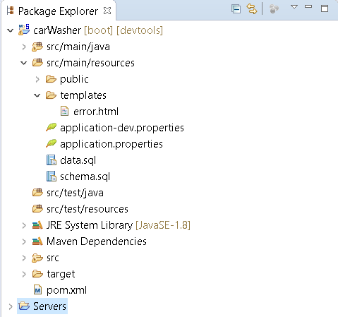
Templated error pages
Notes:
AS SUGGESTED, ONE OF THE FIRST OPTIONS IS TO OVERRIDING THE ERROR PAGE WITH YOUR OWN TEMPLATE.
FOR THIS POST, WE CAN TAKE THYMELEAF AS OUR UNDERLYING TEMPLATING ENGINE.
WE CREATE A CUSTOM ERROR PAGE WITH NAME ERROR.HTML AND SAVE IT UNDER “RESOURCES/TEMPLATES” DIRECTORY.
IN CASE OF ERROR, SPRING BOOT SYSTEM WILL AUTOMATICALLY PICK THIS CUSTOM ERROR PAGE.
ONCE WE ADD ERROR.HTML IN THE TEMPLATES DIRECTORY, SPRING BOOT “BASICERRORCONTROLLER” AUTOMATICALLY PICK OUR CUSTOM TEMPLATE.

Slide 7
ErrorController interface
Another way to manage error handling
To use, implement «ErrorController» interface
Notes:
{click} IF THE THESE OPTIONS ARE NOT SUITABLE FOR YOUR NEED OR IF WE WANT TO HAVE A BETTER CONTROL ON THE ERROR HANDLING MECHANISM, WE HAVE THE OPTION TO EXTEND SPRING’S ERRORCONTROLLER WITH OUR OWN IMPLEMENTATION.
{click} FOR THIS PURPOSE WE NEED TO IMPLEMENT THE ERRORCONTROLLER INTERFACE AND OVERRIDES ITS GETERRORPATH METHODTO RETURN A CUSTOM PATH.

Slide 8

Enf of this course
Notes:
TODAY IN THIS COURSE, WE COVER HOW TO DISABLE SPRING BOOT WHITELABEL ERROR PAGE AND HOW WE CAN CUSTOMIZE THE WHITELABEL ERROR PAGE IN YOUR SPRING BOOT APPLICATION.
THANK FOR JOINING. SEE YOU NEXT CLASS. HAVE A NICE DAY.

